Slide 1

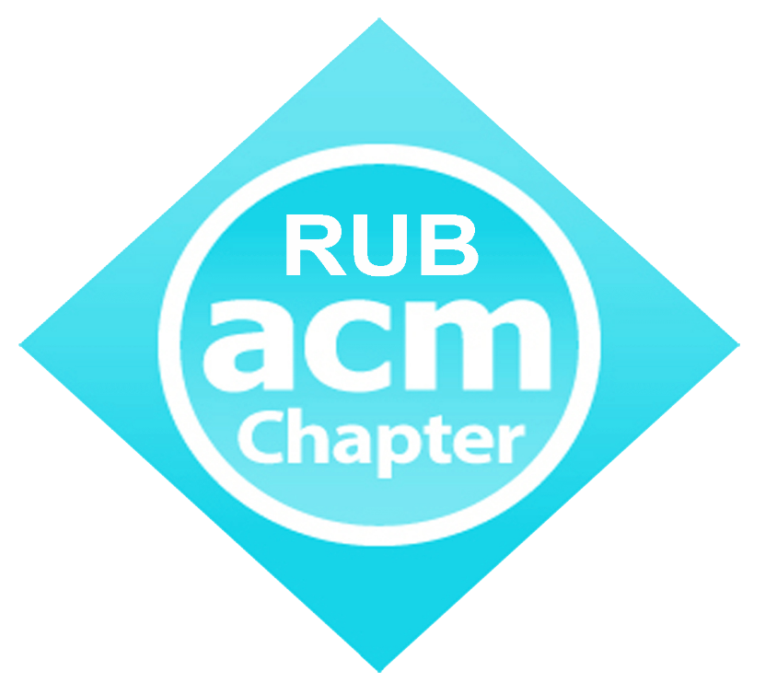
Git and Github
Introduction to Version Control
RUB ACM Student Chapter
College of Science & Technology

Slide 2
Welcome!
In this session, we will go through the basics of Git and Github for version control, with the aim to help you all develop projects in groups

Slide 3
Outline
Theory
Demo
Hands-on

Slide 4
Before Starting
Recollect Programming
Sense of Teamwork, and Dedication
Basic Linux Terminal Commands

Slide 5
…And ask yourself, “How do Developers work in Teams?”

Slide 6
“If you ever talk to a Programmer, you’ll find they know their tools like an artist knows their paint brushes”

Slide 7
GitHub to a Developer, is like Instagram for a Photographer
Shubham Gautam
It is like a group chat of codes

Slide 8
Version Control System
Software tools that help a software team manage changes to source code over time.
Keeps track of every modification to the code.
If a mistake is made, developers can turn back the clock and compare earlier versions of the code to help fix the mistake while minimizing disruption to all team members.

Slide 9
Types of Version Control
Centralized Version Control
Distributed Version Control
Central copy in a server – Programmers commit their code changes to that server.
Other Programmers see the change, and pull it.
Pull -> Change -> Commit
Disadvantages: Commit seen by every one, slow to commit (requires connection every time)
A Programmer can clone a central repository (full history can be cloned)
Advantages over Centralized Version Control – you can commit, and branch on local machine, without interacting with the server
Pull -> Change -> Add -> Commit (multiple) -> Push

Slide 10
Examples
Central – CVS, Subversion, Perforce
Distributed – Git, Mercurial

Slide 11


Git and Github
Git (Distributed Version Control Software)
Free and Open-Source Version Control System for tracking changes in files (mostly source code), and coordinating work on those files among multiple people.
Github (Website)
Web Hub for Git.
It hosts the git repositories, allowing multiple people to access code/files from anywhere in the world.

Slide 12
A bit of History
Development Started
2005
On April 3, after Linus Torvalds felt the need of a distributed VCS
2005
December
First Version Released
June
2018
On 4th June, announced it had reached an agreement to acquire GitHub for US$7.5 billion.

Slide 13
Statistics
24 Million Developers
505,045 students learning on Github
67 Million Repositories
See more at https://octoverse.github.com/

Slide 14
Working of Git and Github
How the push and pull works?
< Explanation on Board >

Slide 15
Benefits of using Git
Repositories
Open Source
Track Changes
A copy of your project on the web. You can showcase your work to others through your repository online, and encourage contributions
In addition to git and github being open source, there are tons of open source projects on github, which you can contribute to, including the linux kernel
You can see and go back to any instance of your project
Branching
Communication
Being a better Dev
You need not worry of breaking a project with git branches
You can communicate your changes to other developers in English, or any language through commit messages
With access to millions of repositories online, you can see the code written by devs around the world

Slide 16
Let’s Dive In

Slide 17
Git Bash Commands
We will be using Git Bash, and not Git GUI
Git Bash uses commands similar to Linux Terminal Commands (such as pwd, cd, ls, and so on)
The git commands are written as
git command-here

Slide 18
Git Configuration
git config user.name “username”
git config --global user.name “username”
git config --global user.email “email”
Remote means github repo online
Local means the current computer you are using

Slide 19
Git Commands
git init : Initializes the current local directory/folder as a git repository
git status : Displays the current status of files, such as, untracked file, new file, and so on.
git add filename.ext OR git add . : Adds files in the local git repo, and stages them for commit
git reset HEAD file.ext : Removes files from stage
git commit –m “Commit Message” : Commits all the added files and makes it ready for pushing
git remote add origin URL
git remote –v : Verifies remote
git push origin master : Pushes Commits to Origin/master

Slide 20
Git Commands
git add –am “Commit Message” : Add and commit in a single command
git clone URL : Clones repo from Github URL
git pull : Pulls master branch
git stash : Saves current working branch
git stash list : Lists currently stashed works
git stash apply : Goes to a particular stashed state
git push : pushes all commits to origin master

Slide 21
Git Commands : Branching
Branching Explanation on Board – Master Branch
git branch : Shows all branches on local machine
git branch branch_name : Add a new Branch
git checkout –b branch_name : creates new branch and navigates to it
git checkout branch_name : Navigates to a branch
git push –u origin branch_name : Creates a branch in remote and pushes (used for first branch push)
git push origin branch_name : Pushes a branch (used after first push)
git merge branch_name : Merges a branch into currently checked out branch (usually Merging into Master)

Slide 22

Merging into Master

Slide 23

Merge Conflicts

Slide 24
Pulling a branch from Repo
Note that git pull downloads/pulls the master branch
git checkout –b desired_branch_name origin/branch_name_on_github
BUT
git fetch OR git fetch a_particular_branch first

Slide 25

Theory & Practice sometimes clash. And when that happens, Theory loses. Every Single time.
- Linus Torvalds

Slide 26
Thank You

